Slide 1
Lecture 1
C++ Programming
Arne Kutzner
Hanyang University / Seoul Korea

Slide 2
Contact
Contact data:
  E-Mail kutzner@hanyang.ac.kr
  Office Room 77-714
All course material will be available on Hanyang-LMS
09/2022
Introduction to C++ Programming
L1.<number>

Slide 3
Prof. Dr. Arne Kutzner / Weekly Schedule 2022.2
 | Mon | Tue | Wed | Thu | Fri
9:00 – 10:30
10:30 – 12:00
12:00 – 13:30
13:30 – 15:00
15:00 – 16:30
16:30 – 18:00
C++(B)
11:00 - 13:00
(ITBT – 508)
C++(B)
11:00-13:00
(ITBT – 703)
C++(A)
13:00-15:00
(ITBT – 202)
C++(A)
13:00-15:00
(ITBT – 703)
Exercising
Exercising
Alg. Analysis
16:00– 17:30
(ITBT – 203)
Alg. Analysis
16:00-17:30
(ITBT – 203)
09/2022
Introduction to C++ Programming
L1.<number>

Slide 4
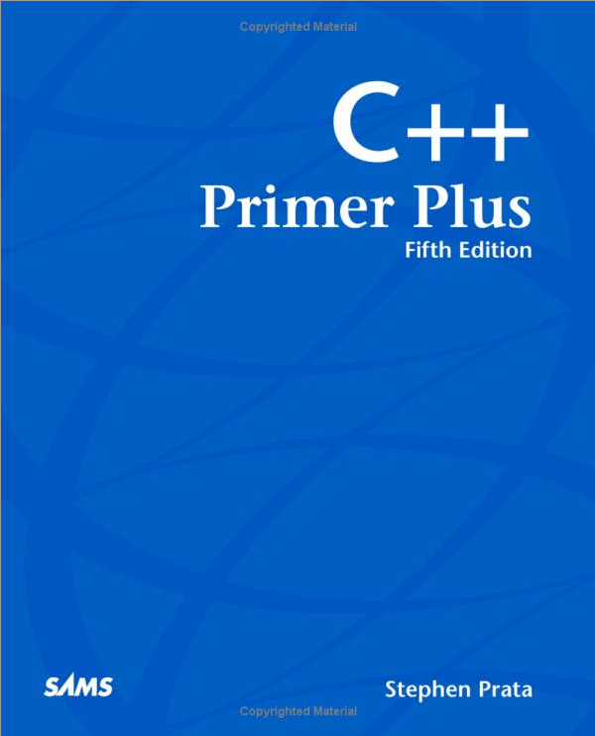
Literature (suggestion merely!)
Stephen Prata,
C++
Primer Plus
(6 Edition),
Addison-Wesley Professional, 2012.
Korean version available
09/2022
Introduction to C++ Programming
L1.<number>

Slide 5
Textbook is a suggestion merely / You do not have to buy it!
C++ is standardized, so in all textbooks on C++ is finally the “same story”.
  There are even some free textbooks on C++ available in the WEB
There are many good C++ tutorials in YouTube etc.
Answers for more specific questions can often be found in: https://stackoverflow.com
09/2022
Introduction to C++ Programming
L1.<number>

Slide 6
Goals
Introduction to the C++ Programming Language and the basic concepts of Object Oriented Programming
  Understanding of the notions Object, Class and Inheritance
  Gaining of basic programming skills
  Understanding the position of C++ in the context of other programming languages (Pyhton, Rust, Java, C#)
09/2022
Introduction to C++ Programming
L1.<number>

Slide 7
Provisional Schedule
Week
2 | Introduction, Basic Datatypes, “Hello World”-Program
3 | Control Structures, Expressions, Operators
4 | Functions, Function Overloading, Recursive Programming
5 | Arrays, Definition, Searching and Sorting of Arrays
6 | Pointers and Pointer Arithmetic
7 | Structures, Enumerated Types, Bitwise Operators
8 | Midterm Examination
9 | Foundations of OO-Programming, Class Definitions
10 | Encapsulation in C++ (public versus private), Constructors
11 | Inheritance (protected modifier), Method Overriding, Polymorphism
12 | Exception Handling, Try-Catch-Blocks
13 | C++ Templates, Intro to Standard Templates (STL)
14 | STL cont., Remarks on C++03, C++11,C++14, C++17, C++20
15 | Final Examination
09/2022
Introduction to C++ Programming
L1.<number>

Slide 8
Structure of the Course
Lecture
  Offline Lecture in room 202
Exercising Classes in room 703
  TA will repeat highlights of lecture and exercise with the students
  Opportunity to make friends and to „sozialize“
  Please check Hanyang-LMS for annoucements
Homework Assignments
  Homework is for the preparation of midterm and final examination
  Reports have to be submitted as PDF via Hanyang-LMS
09/2022
Introduction to C++ Programming
L1.<number>

Slide 9
Grading
Composition of final grade:
  Midterm Examination - 35%
  Final Examination - 35%
  Homework Reports - 20%
  Attendance - 10%
  (5% Lecture, 5% Exercising)
09/2022
Introduction to C++ Programming
L1.<number>

Slide 10
Absolute Grading
A from 90% of max. reachable points
  (A+ 95% min)
B from 75% of max. reachable points
  (B+ 85% min)
C from 60% of max. reachable points
  (C+ 70% min)
D from 45% of max. reachable points
09/2022
Introduction to C++ Programming
L1.<number>

Slide 11
Foreigner specific …
Lecture will be in English
  Additionally, I will upload old recorded classes on Hanyang LMS for conveniently repeating the material
TA’s Exercising will be primarily in Korean
  Please attend the exercising classes although they are in Korean
  The exercising is a great opportunity to “pick up” some Korean Language knowledge
Be careful regarding your attendance record! You have to attend at least 2/3 of all classes or you can not pass the course,
09/2022
Introduction to C++ Programming
L1.<number>

Slide 12
Maximal number of attending students – (Covid 19)
Due to the maximally 48 seats in room 703 and the Covid 19 regulations, the number of participating students must be limited to 48 students.
Therefore, this semester, I cannot give attendance permissions via E-Mail or via offline forms.
09/2022
Introduction to C++ Programming
L1.<number>

